Slide 1
PREFACE
Hi all! Thank you to Steven Dorfman first and foremost, Mike Panesis, the Hub101 team, CLU, and all of you for supporting local entrepreneurs like myself. Since I cannot be there to talk through the pitch deck, I have adapted it be more thorough and less like a traditional pitch deck. Thank you!
James Coleman

Slide 2
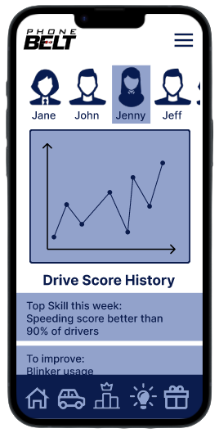
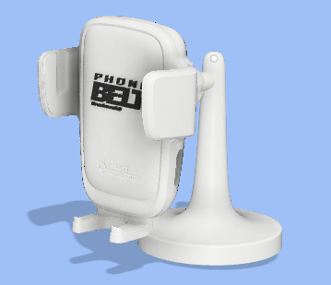

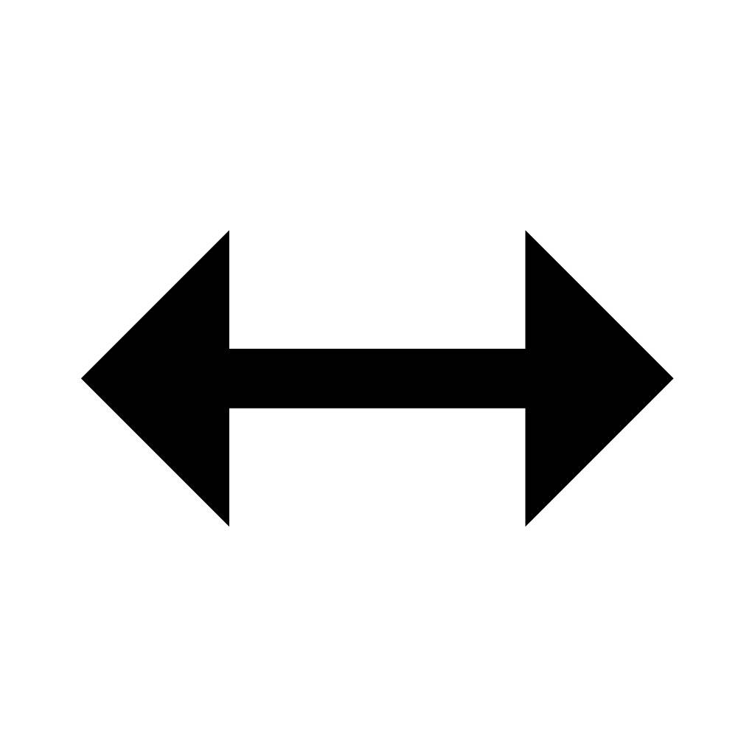



BLE
Cellular
Beacon
App
Cloud

Slide 3
OUTLINE
01
04
02
05
03
06
The Problem
Market Analysis
Current Solutions
About PhoneBelt
Grant Questions
Introducing PhoneBelt

Slide 4
Mission
To reduce distracted driving and make our roads safer.

Slide 5
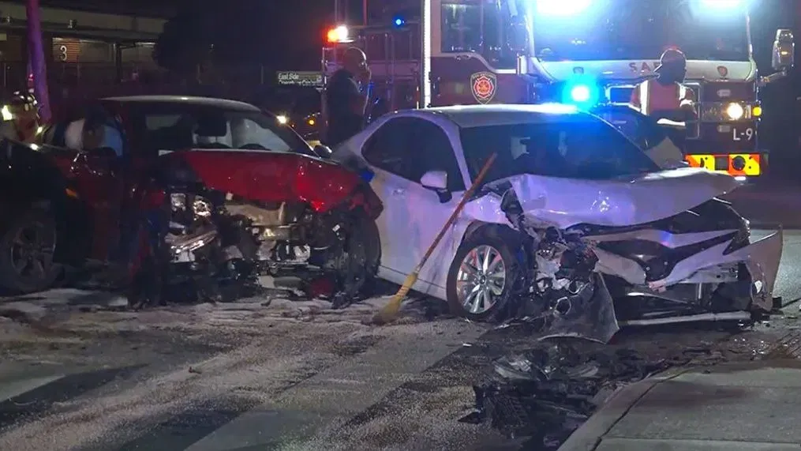
01
THE
PROBLEM

Slide 6
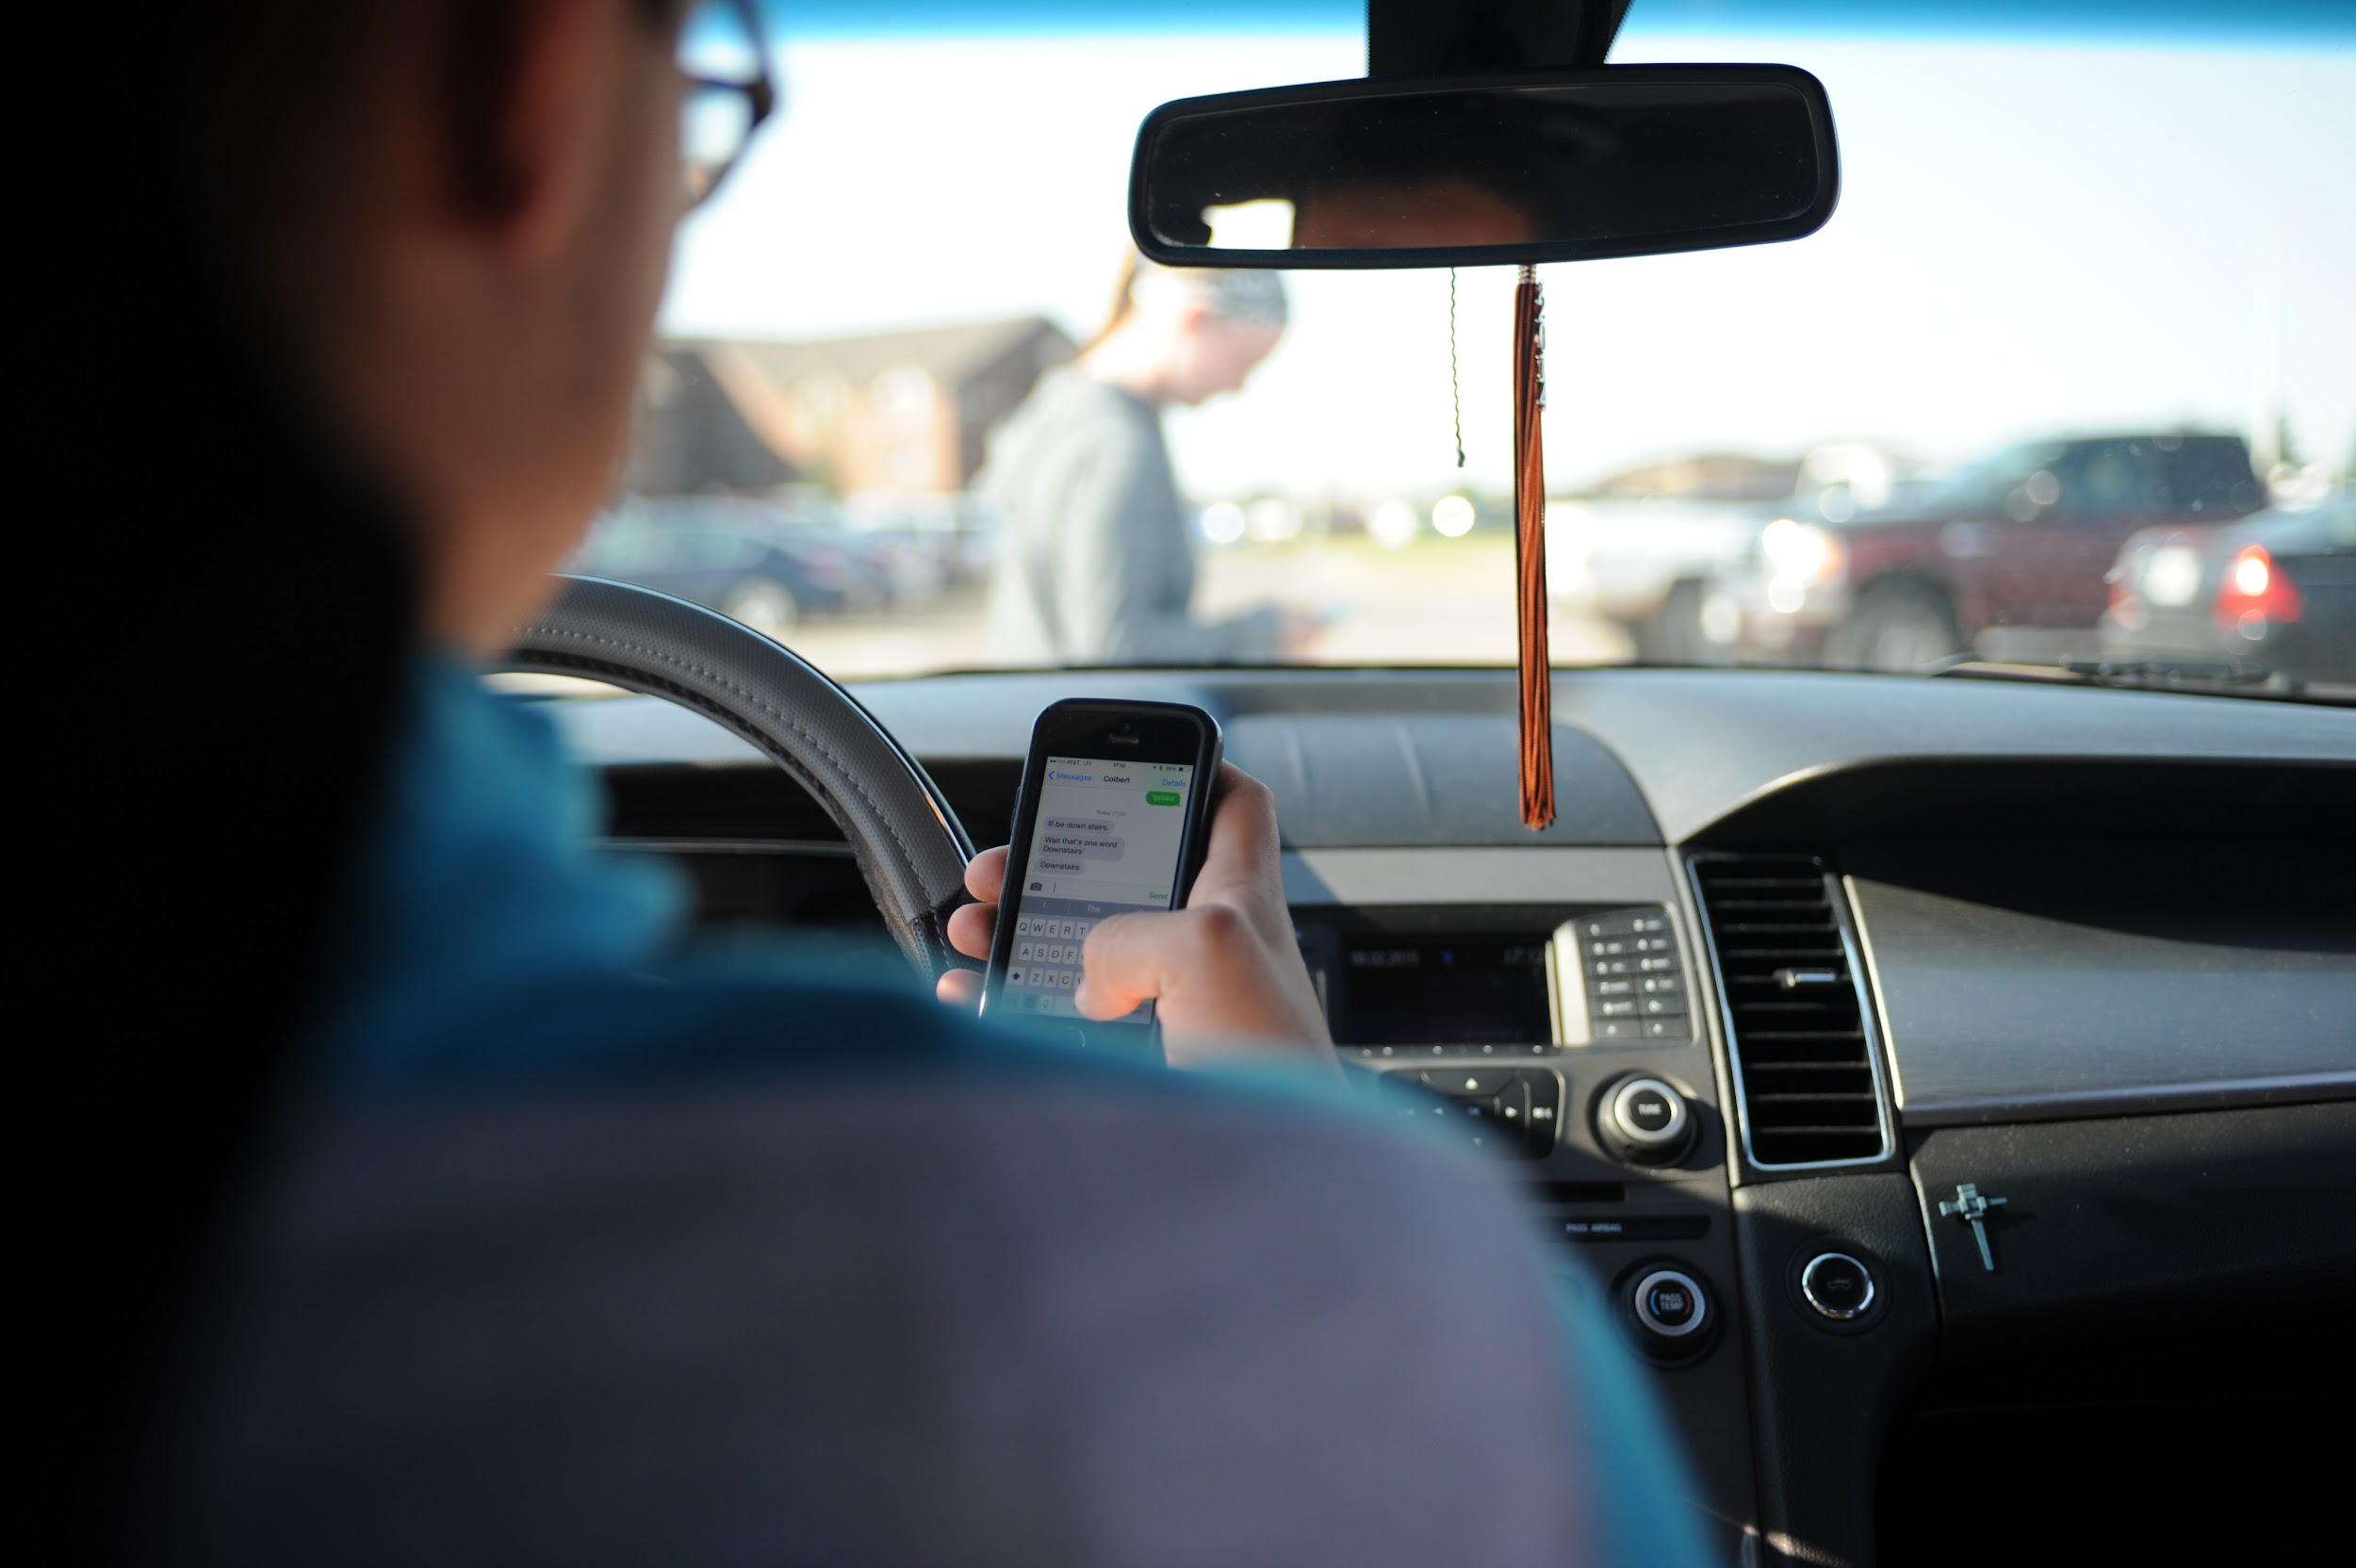
THE PROBLEM
Over ¼ of accidents are caused by cellphones (NSC)
Almost 9% of all fatalities are linked to distracted driving. (DOT)
Physical phone manipulation is rising every year (IIHS)

Slide 7
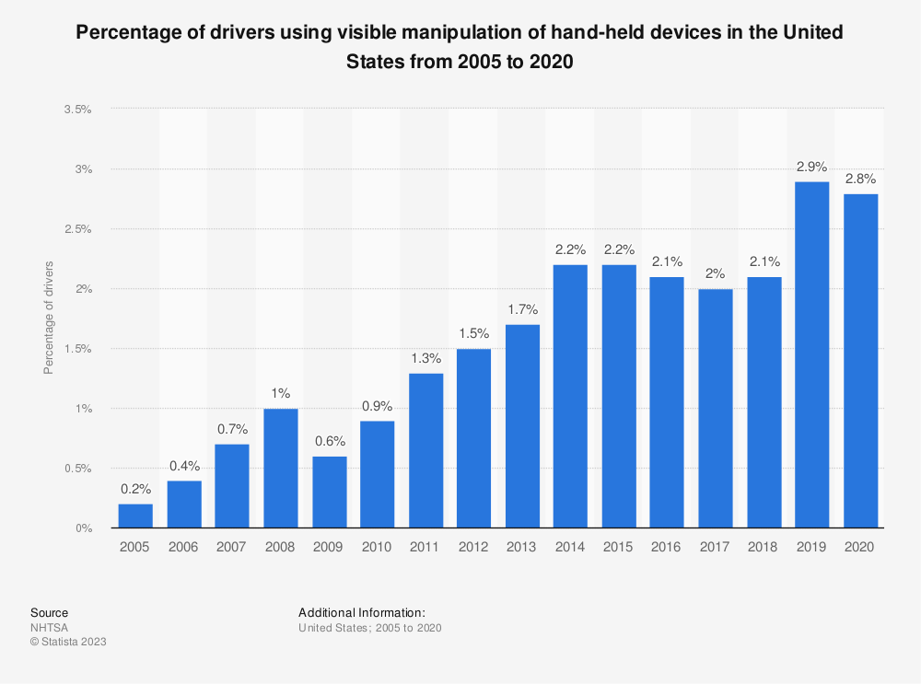
WORSENING PROBLEM
Despite many solutions existing, the problem is getting worse not better
Handheld phone use is rising year over year
Current solutions do not cut it

Slide 8
MORE AND MORE DISTRACTED
2000
2010
2020
Calling
While driving
Texting
While Driving
Instagram
Facebook
Tiktok
etc.
Not only are more people using the phone while driving, but the magnitude of distraction is getting worse and worse each year
There is a generational divide. The younger the driver is, the more they use their phone and social media when they drive. The way you and I use our phones while driving is not how teens do it.

Slide 9
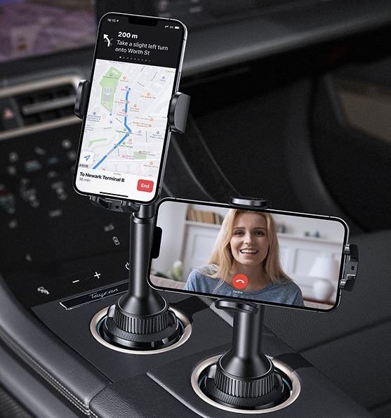
02
Current Solutions

Slide 10
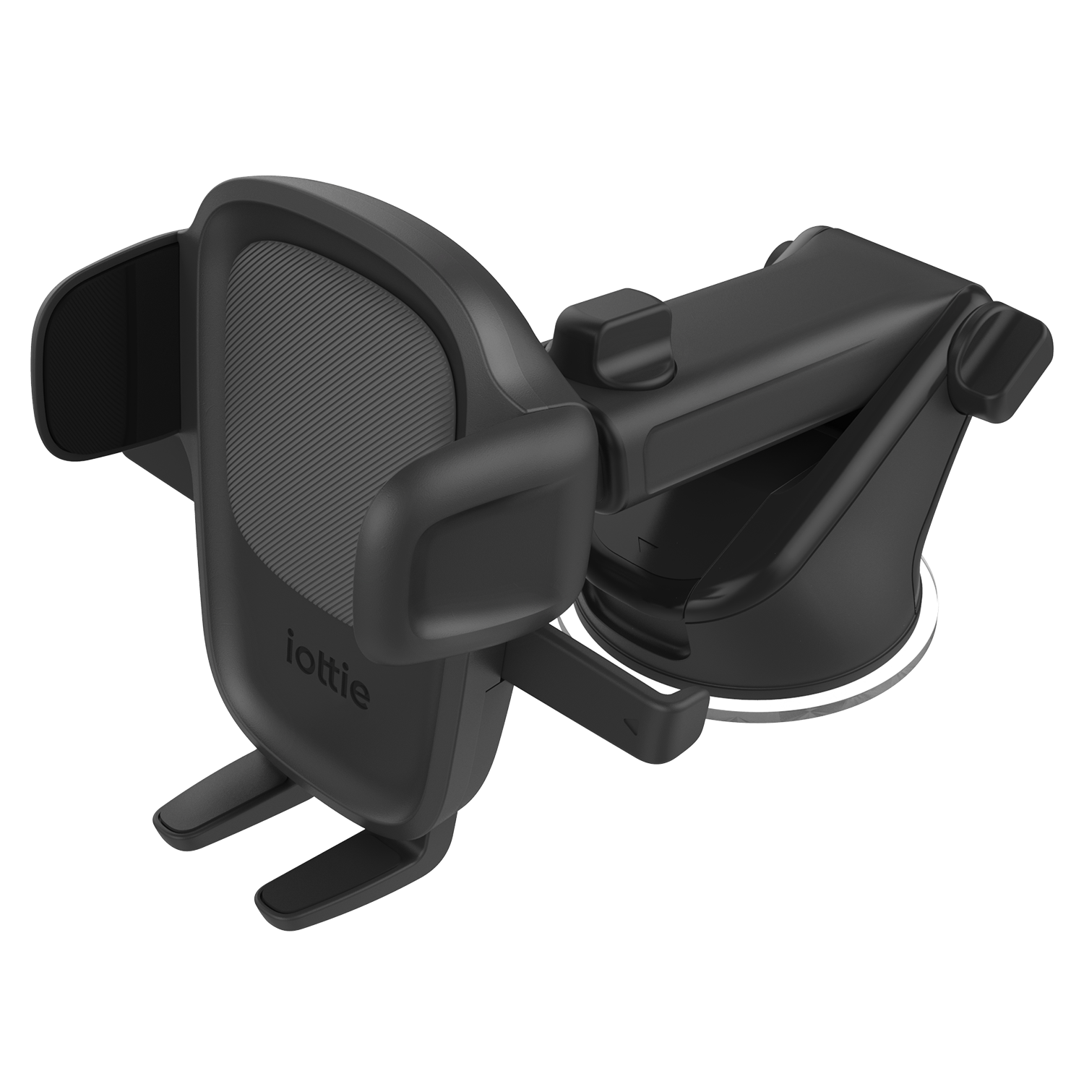
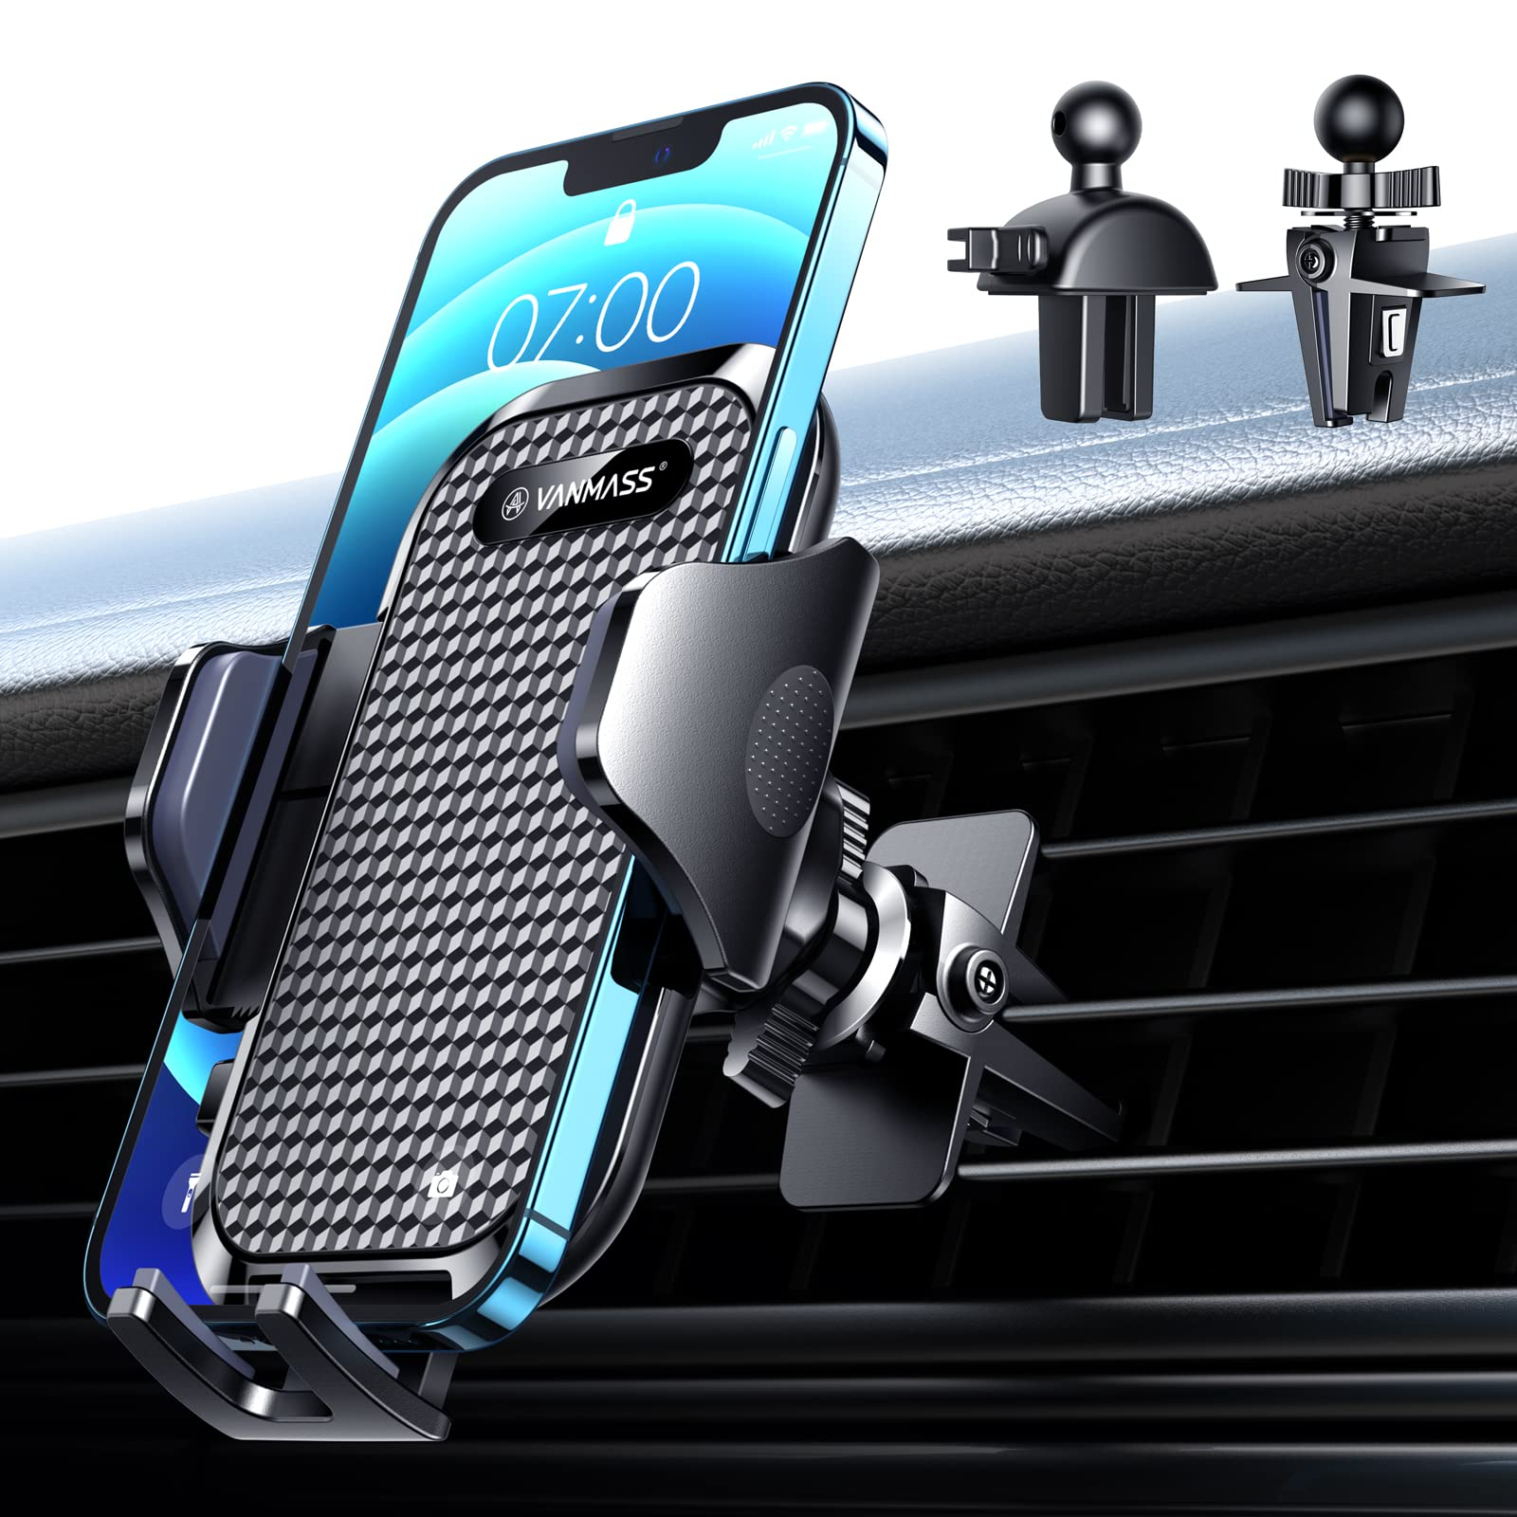
PHONE MOUNTS
Allow drivers to access their phone in a safer way. Phone use while in the mount is safer (Accident Analysis & Prevention)
Unfortunately, most drivers simply take their phone out of the mount when they use their phone. Therefore, no effect on safety (FHWA)
The gist
Phone mounts are great when used properly. They usually are not used properly. Ineffective.

Slide 11
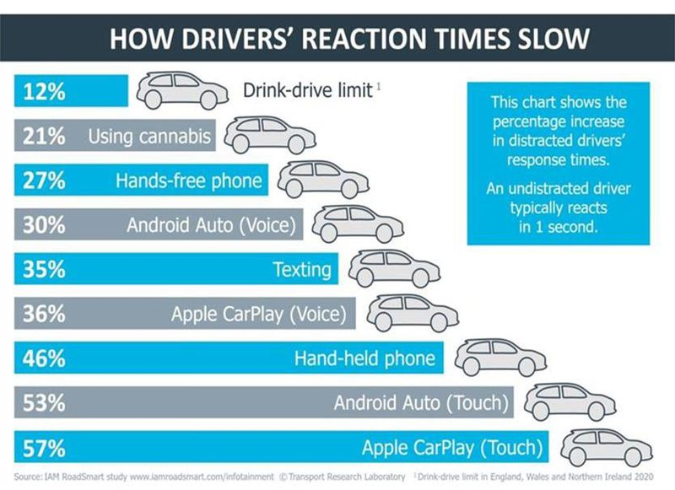
Apple Carplay/ Android Auto
Apple Carplay/ Android Auto
Actually more unsafe than handheld phone use
Peripheral attention is important. These solutions shift driver gaze furthest from the road.
Reaction time is worse than handheld phone use

Slide 12
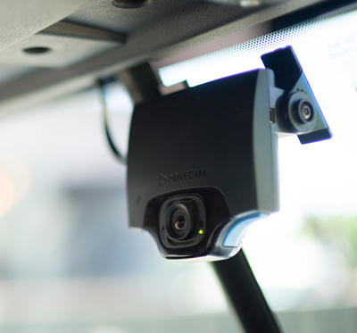
How do businesses solve this problem?
Driver Facing Cameras
A solution that works very well. These cameras monitor driver behavior, chime when drivers are on their phone and save recordings in the event of an accident. They have successfully saved fleets billions in distracted driving costs.
Why has this has not worked in the B2C market?
Drivers do not like being monitored and they value their privacy very highly. Driver facing cameras make drivers extremely uncomfortable because they do not like being watched. They are extremely expensive to setup and the ongoing cellular connection is expensive to maintain. Needs to be professionally installed and hardwired into vehicle. Can be covered with a post-it note.

Slide 13
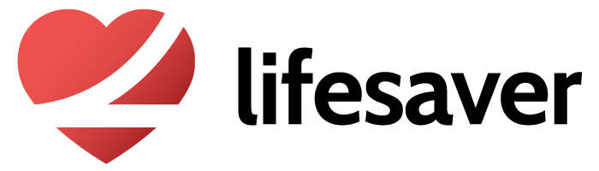
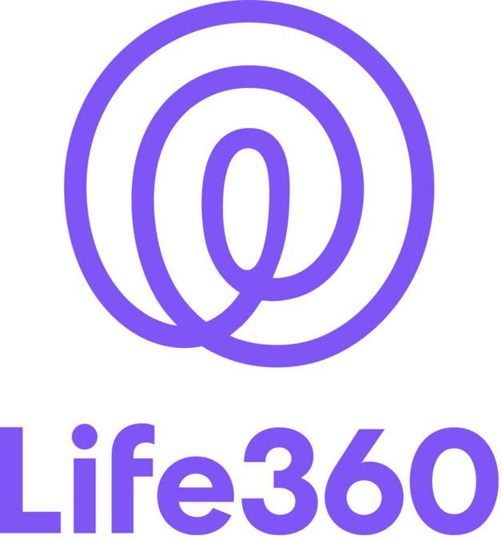
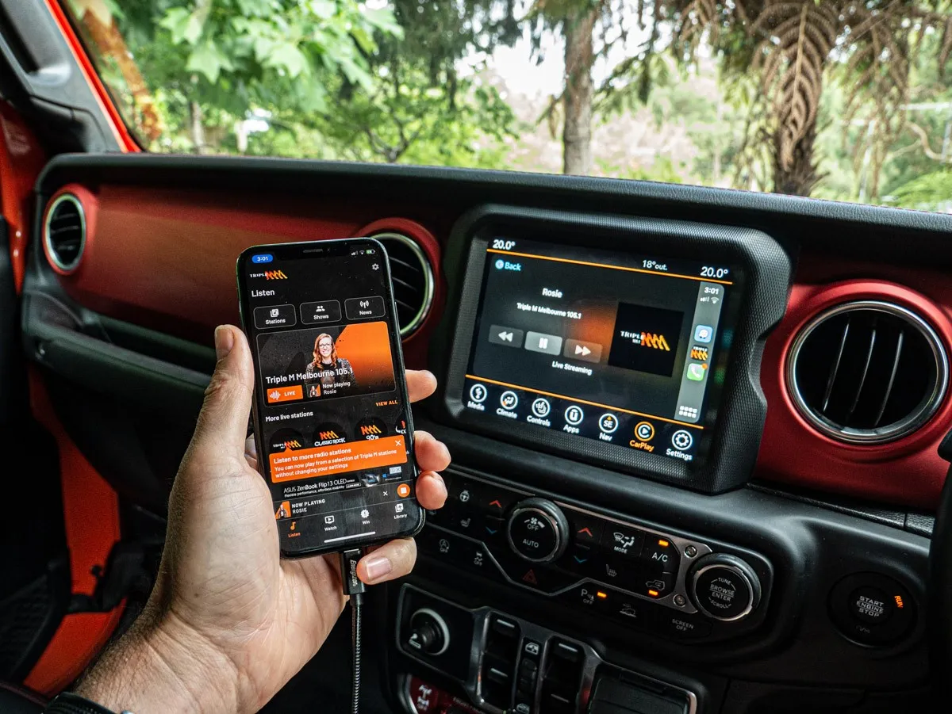
OTHER SOLUTIONS
Software/ App Solutions
Inaccurate. Apps cannot differentiate between drivers, passengers, busses, etc.
Apps need constant cellular connection
Apps must be turned on by the user before each drive and can be easily turned off at any point (swiping the app away, turning location services off, etc.)
Invasive of privacy and unpopular
They have no systems to enforce compliance
The gist
The evidence is clear, current solutions do
not work.

Slide 14
The safest place to have your phone while driving is at home.
That is not realistic.
We need a solution that allows the phone to be used as a tool to be used for: work, calls, GPS, etc. but not for things like social media

Slide 15
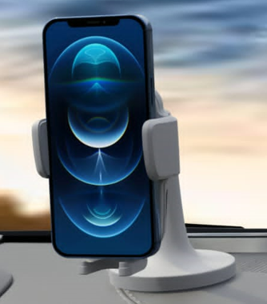
03
Introducing PhoneBelt

Slide 16
THE SOLUTION
The PhoneBelt is a patent pending smart mount that detects two things: 1. If your teen is driving and 2. If your teen’s phone is buckled into the mount
If the cellphone is taken out of the mount while driving, PhoneBelt begins chiming, just like a seat belt, until the phone is returned to the safety mount
The PhoneBelt keeps the driver safe by keeping phone use productive and not distracting. The PhoneBelt positions your teenager’s cell phone in the safest position with the road in the peripheral vision - not on their lap (where most phone use occurs)

Slide 17
THE SOLUTION
The chiming alarm not only changes driver behavior in the moment, but it also leverages classical conditioning to change habits over time. Phone use while driving gets associated with the annoying chime leading to long term positive shifts in driver behavior
Like the seat belt, the PhoneBelt has is a tremendous opportunity to build good driving habits, reduce accidents, and save lives.

Slide 18
Other Features & Innovations
Wireless Charging
Get rid of all the wires around your car
Easy Touch Activation
Detects your phone and auto clamps using a small motor. Press button on the side for a quick release. Motorized arms for a better grip
Strong Adhesive
A 3M adhesive to have it stick on & stay on.
No Hassle Setup
Unlike other mounts, our better design comes pre assembled which saves you installation time. Just stick and wait.
Silence Non-Urgent Notifications
NFC tech that puts your phone in a Do Not Disturb While Driving mode to silence non-urgent & distracting notifications like social media updates

Slide 19
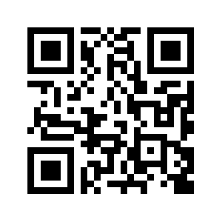
Demo
https://youtu.be/QCW7UKiA8wA

Slide 20
TARGET CONSUMER
Sally is the mother of two kids. Her eldest, Jake, just turned 16 and earned his driver's license. Sally is planning on buying Jake a used car to celebrate and so he can start driving himself to and from school. She is excited to get a break from driving, but she is also worried about Jake driving unsupervised. She sees Jake using his phone all the time (with friends, watching TV, while eating dinner) and she worries he won't stay off the phone while driving either. He loves watching TikTok whenever he has free time and she has already seen him check his phone during stop lights. Sally wants Jake to be safe and feels out of control when she's not in the car with him.

Slide 21
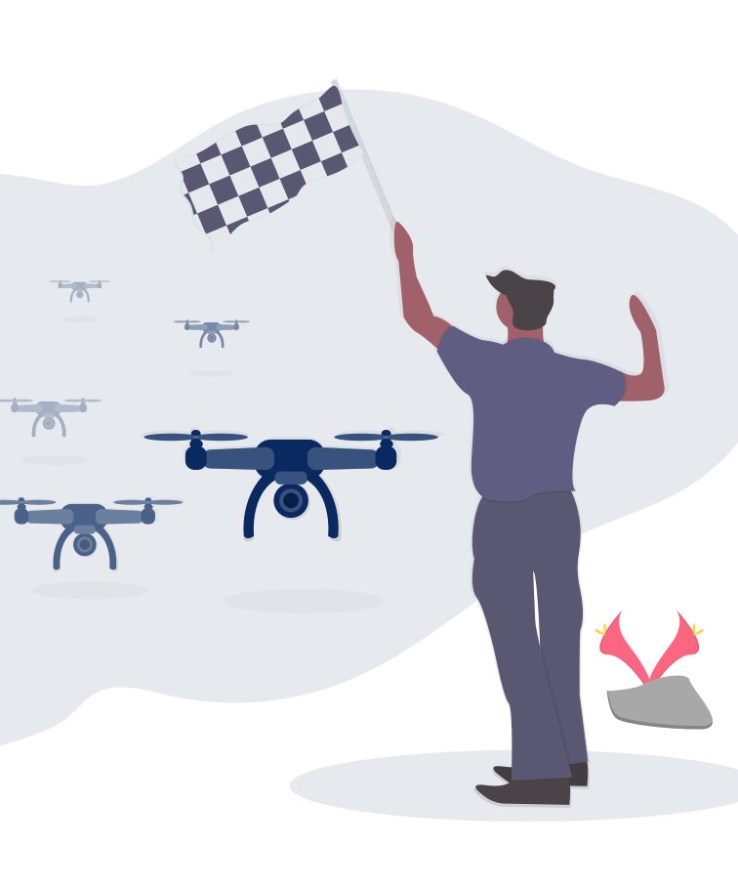
04
Market
Analysis

Slide 22
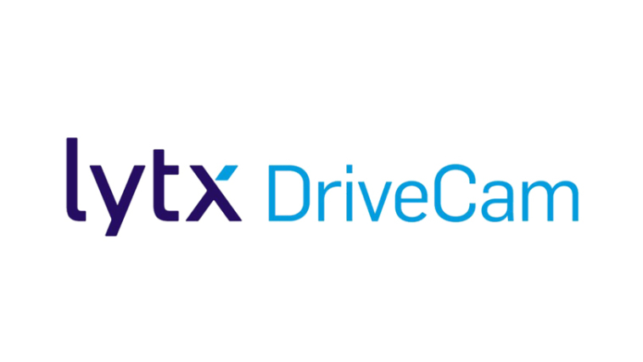
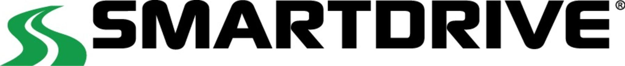



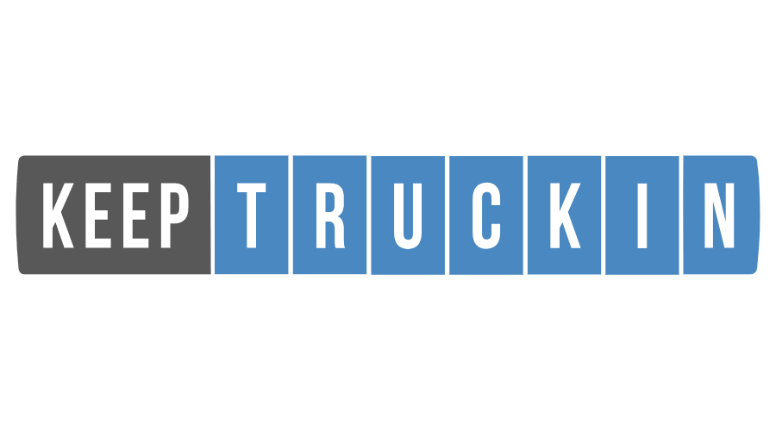
B2B SOLUTIONS
Several billion dollar B2B companies that tackle the problem of commercial distracted driving. They all use driver facing cameras to monitor phone use. Driver facing cameras are extremely effective in the B2B market
Notes:
Many billion dollar companies born out of this problem already

Slide 23
B2C SOLUTIONS
……?
There are many billion dollar companies born from servicing the commercial trucking market…
what about the, even larger, B2C market?
There are still no good solutions for the B2C market.
Notes:
Barely any B2C focus despite being the bigger market -people do not want cameras in their car

Slide 24
MARKET SIZE
TAM
2023 car accessory market size (Vintage Market Research)
SAM
285 million vehicles in the United States alone; not considering the global market
SOM
9 million teenagers with driver licenses in the United States alone
Projected $100 selling point
TAM: 470 Billion
av
SAM: 28.5 Billion
SOM: 900 Million

Slide 25
FUTURE TARGET MARKETS
(after the teen driver)
SMB Commercial Driving
Commercial fleets that do not buy $1000+ driver facing camera systems. PhoneBelt is a cheaper alternative. Aside from trucking, driver facing cameras do not have high saturation, not enough time spent driving to justify the expensive and unpopular solution
Camera systems face steep adoption curves as they are extremely disliked; unions ban them
Largest B2B segment, door to door services, has no solutions in place. Driver facing cameras have no saturation. Ex: Landscaping, gas companies, AT&T trucks, etc.
Insurance Interest
Long history insurers partnering with safety technologies
Discounted premiums for drivers with PhoneBelts. It’s in the insurers best interest. Saves them $. Create a financial incentive for all drivers, not just teens, to install PhoneBelts in their vehicles
Notes:
Insurance companies have pushed for mandatory seat belt and drunk driving laws, speed limits, distracted driving laws, vehicle safety standards, and infrastructure improvements (guard rails).

Slide 26
MORE CUSTOMER SEGMENTS
Rideshare
Rideshare companies bear the cost of accidents - it’s their insurance that covers accidents.
Drivers must use their phones while working.
Passengers want safe and reliable rides
A partnership would provide direct marketing to a key customer segment. Being in high traffic vehicles with many passengers will create network effects where the key product exposure is seen by thousands of passengers
Rental Companies
Currently have no solutions in place at all
Rental vehicle companies like UHaul, Enterprise, or Hertz bear major costs when a renter gets into an accident.
Accidents are extremely expensive. They’re so expensive that many rental companies refuse to rent to their largest customer segment, drivers <25
PhoneBelts can be a strategic tool to reduce accidents and access this large customer segment
Can be installed on high risk vehicles and be omitted from premium vehicles, pushing customers to higher margin, premium, vehicles
Offers high product visibility and exposure to renters as they use the vehicle

Slide 27
CUSTOMER ROADMAP
SBIR/ DOT/DMV/ OTS / NHTSA
01
02
Parents Of Teen Drivers (hair on fire customer)
Sell internationally
03
Rideshare & Rental Companies
04
Door to door fleets
03
06
Legal Requirement?
Partnerships with Insurance Agencies
05

Slide 28
MARKETING PLAN
how we are going to get our message to consumers
One key perk of a startup in the teen safety space is the amount of resources and organizations with aligned interests. The Department of Transportation and other government agencies spend hundreds of millions of dollars each year educating drivers on safe driving habits, giving grants to car safety related technologies, promoting technology solutions and much more. The safety category has some of the highest net promoter scores - everyone has a story of a texting and driving accident. Unfortunately, there are many charities/ non-profits born out of tragedies. These organizations work with companies like PhoneBelt to promote their solutions. High schools and school districts host distracted driving month and red ribbon week campaigns to promote safer driving. Driving schools are partners with aligned interests of teen car safety and are direct conduits to our target customers, parents of teenagers. Countless grants from insurance companies for the commercialization of safety related technology and insurers have a long history of helping promote such products.

Slide 29

05
About Us

Slide 30
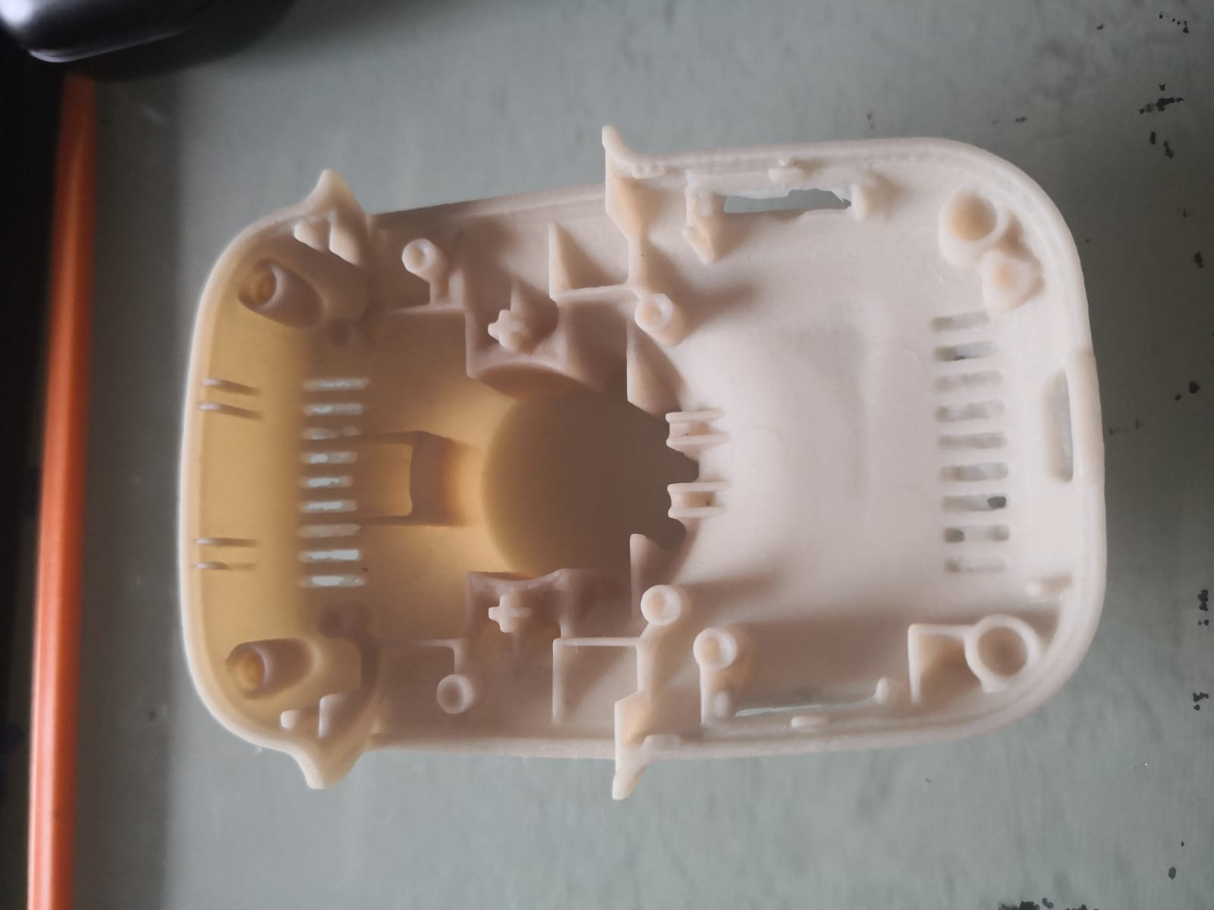
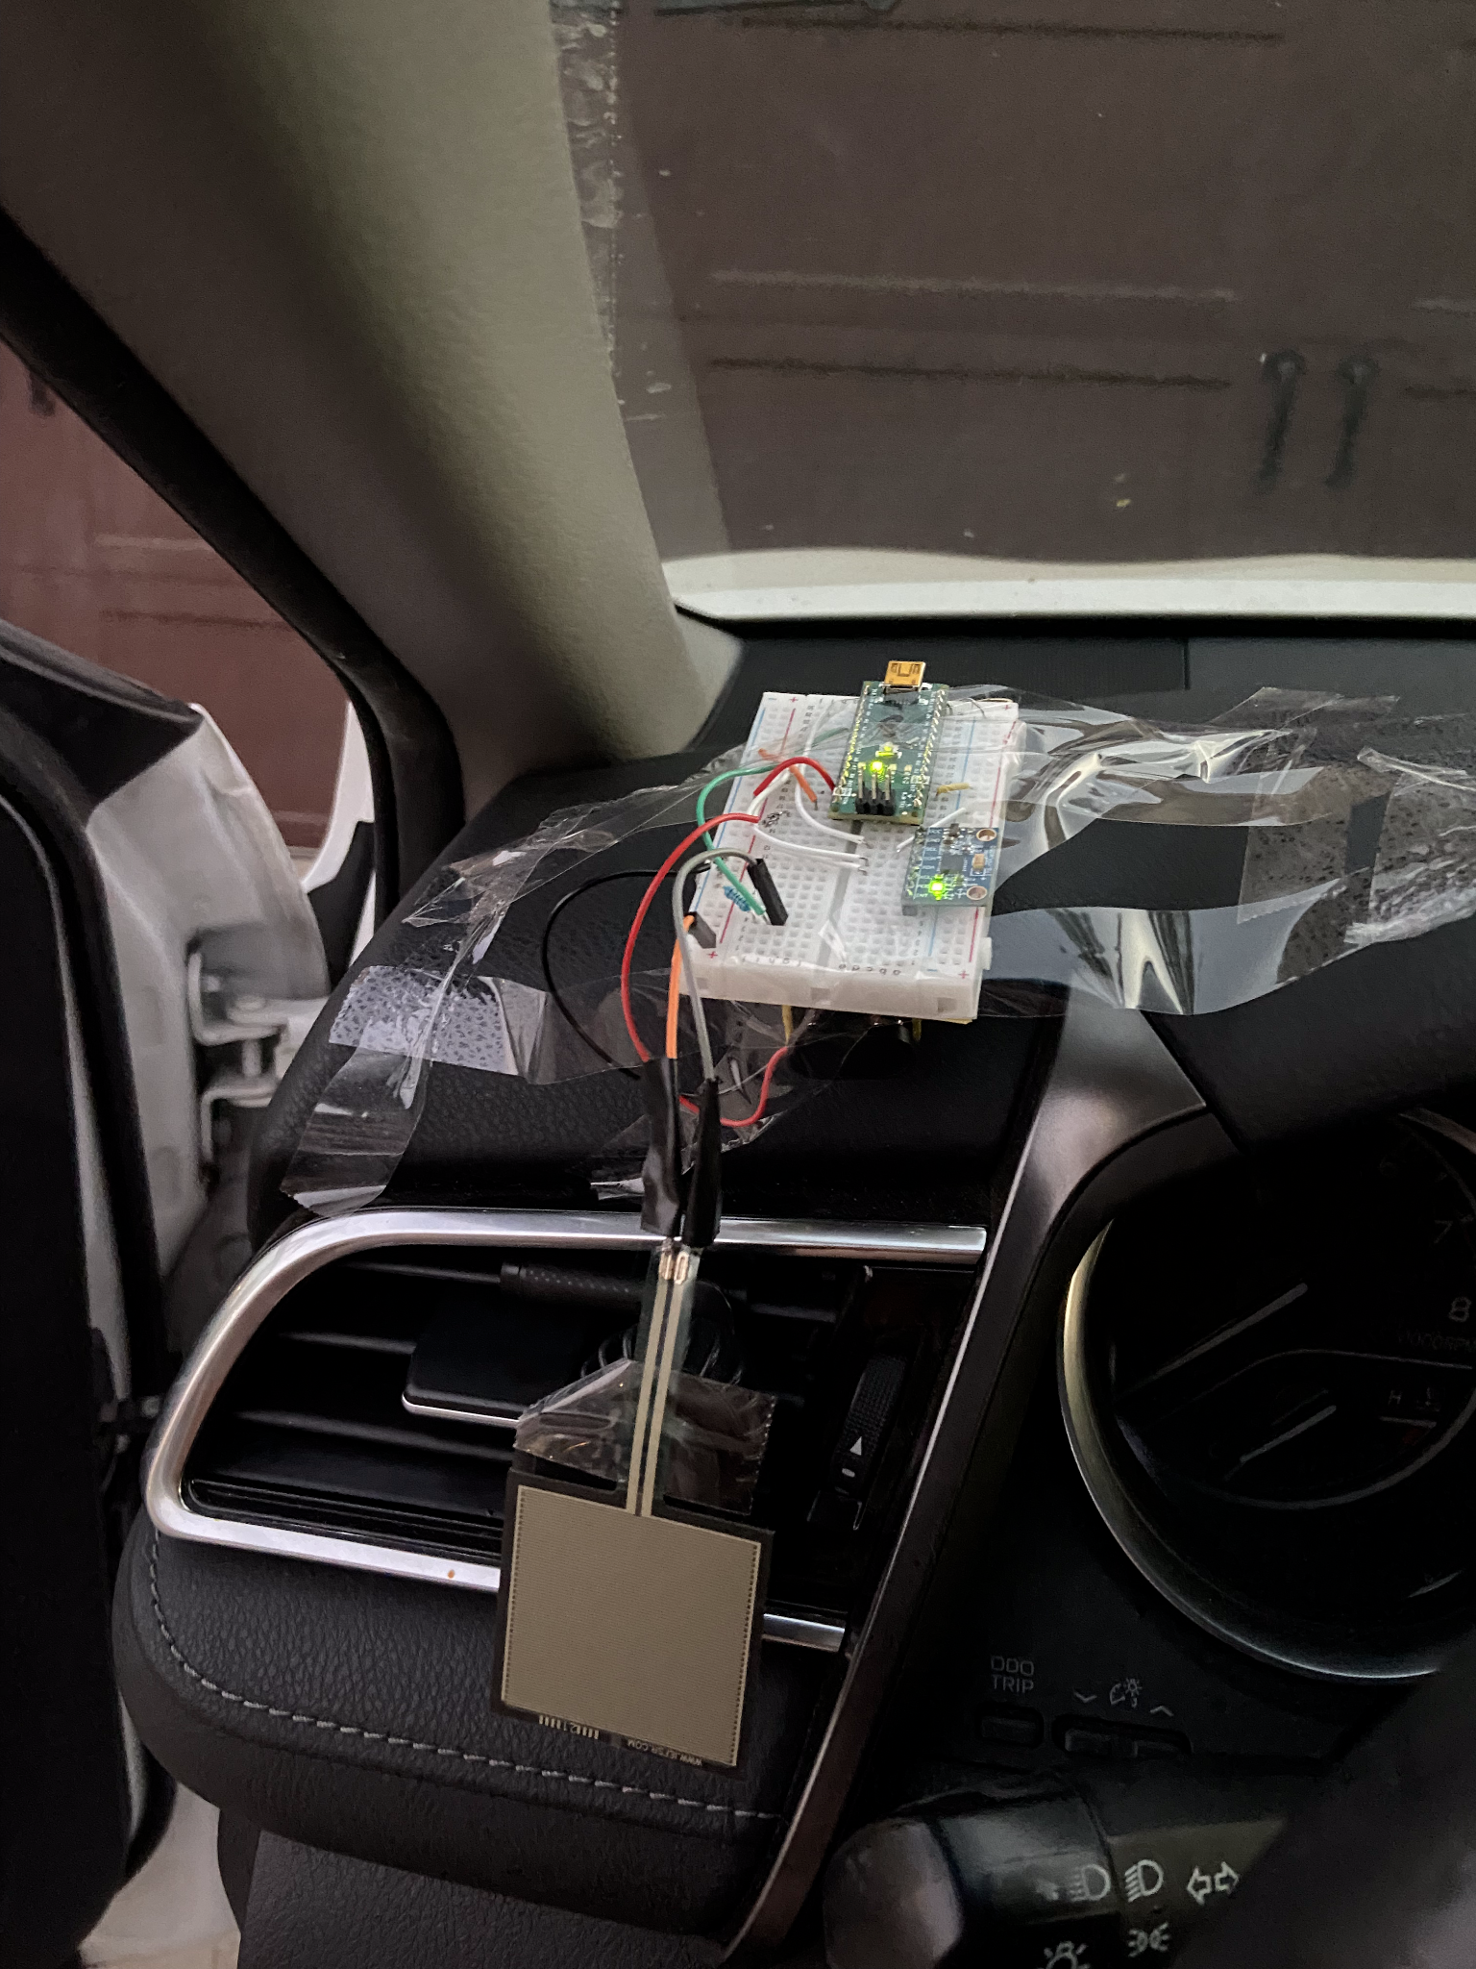
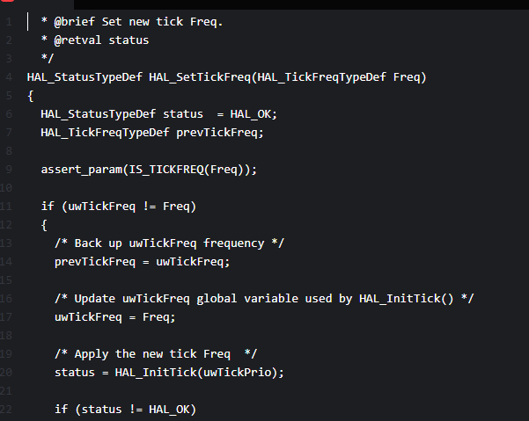
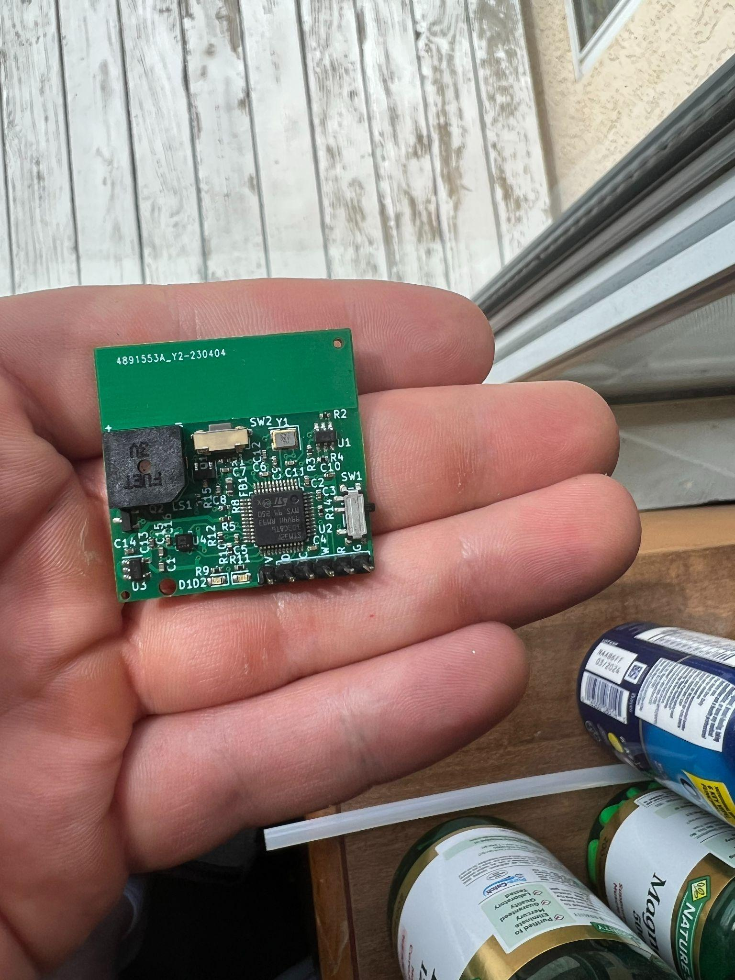

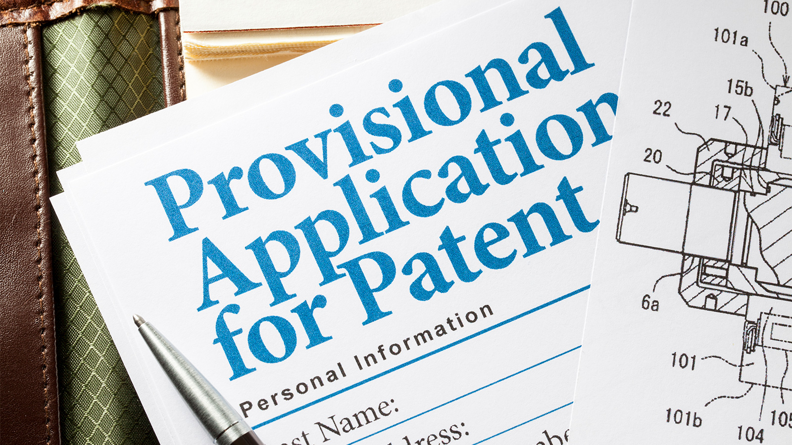
PREVIOUS MILESTONES
Enclosure Designed
MVP
Schematic
Custom PCB
Patent Pending
Legal Entity

Slide 31

OUR VALUES
Other than our commitment to road safety and the reduction of distracted driving, we have one other key philosophy. To be the most customer centric company. We believe customer discovery is not just a step when building an MVP but an ongoing process. We have been talking to customers throughout the process of creating PhoneBelt and we learned from our customers what to built. The original premise was of a lock box that would lock the phone away until the car was parked... The reason we have so many strategic partners and so many future customer segments is because so frequently when we interview customers, they say “wow, this would be perfect for XYZ”. Being customer focussed and building things customers want is our North Star.

Slide 32
FUTURE MILESTONES
Design for Manufacturing/Assembly (Aug 2023)
This summer James will be attending an accelerator to recreate the PhoneBelt in a way that is optimized for scalability
2. Launch Kickstarter (Sep 2023)
Generate pre-sales and also use the pre-sales as point of leverage for better CM and investor terms
3. Launch dedicated B2B version (June 2024)
As opposed to the current model which emphasizes an easy installation, a B2B version that is installed will be more reliable and provide a better moat over time.
Our business model will also grow in sophistication over time from a D2C model, to also having HAAS segments (for B2B), to adding telematics/ GPS data services as well.

Slide 33
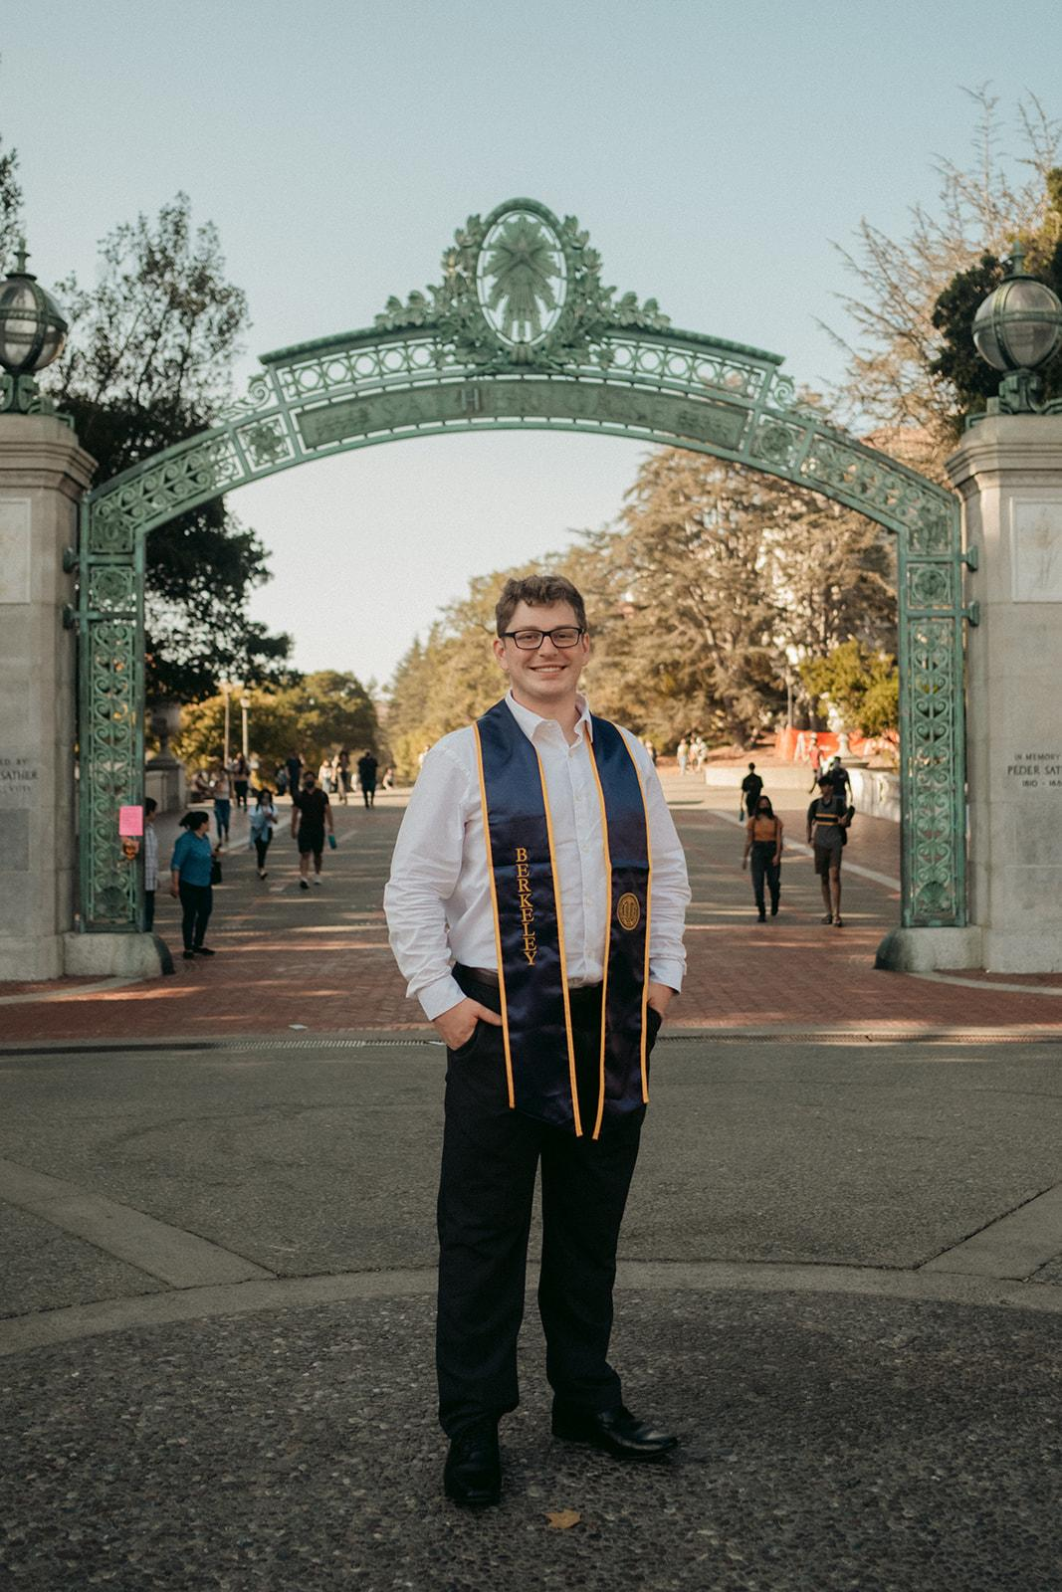
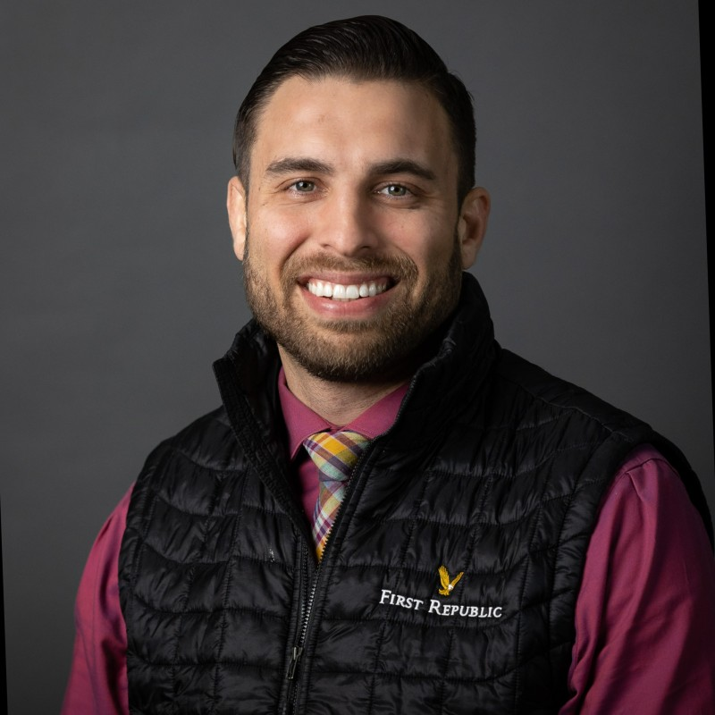
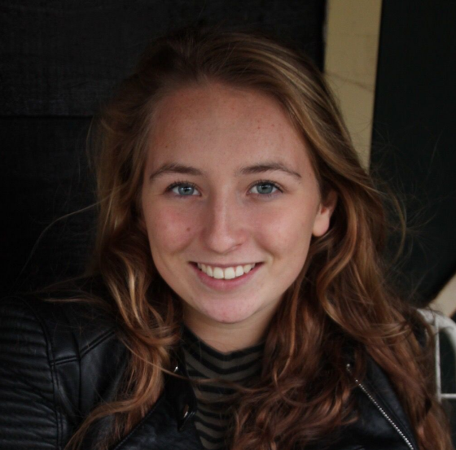
THE TEAM
James Coleman
Jim Whitehouse
Anthony Gonzales
Kemi Dijkstra
Chief Inventor
Electrical Engineer
Financial Advisor
Head of Marketing
Serial inventor & electronics hobbyist
Current CLU MBA student
Berkeley Grad
30 years as Principal Engineer at Rockwell Collins
Retired electrical engineer
Former founder who has raised over 11 million
Fundraising and banking expert
Born in the Netherlands & knows EU market
CLU MBA ‘23
Expert in Marketing

Slide 34
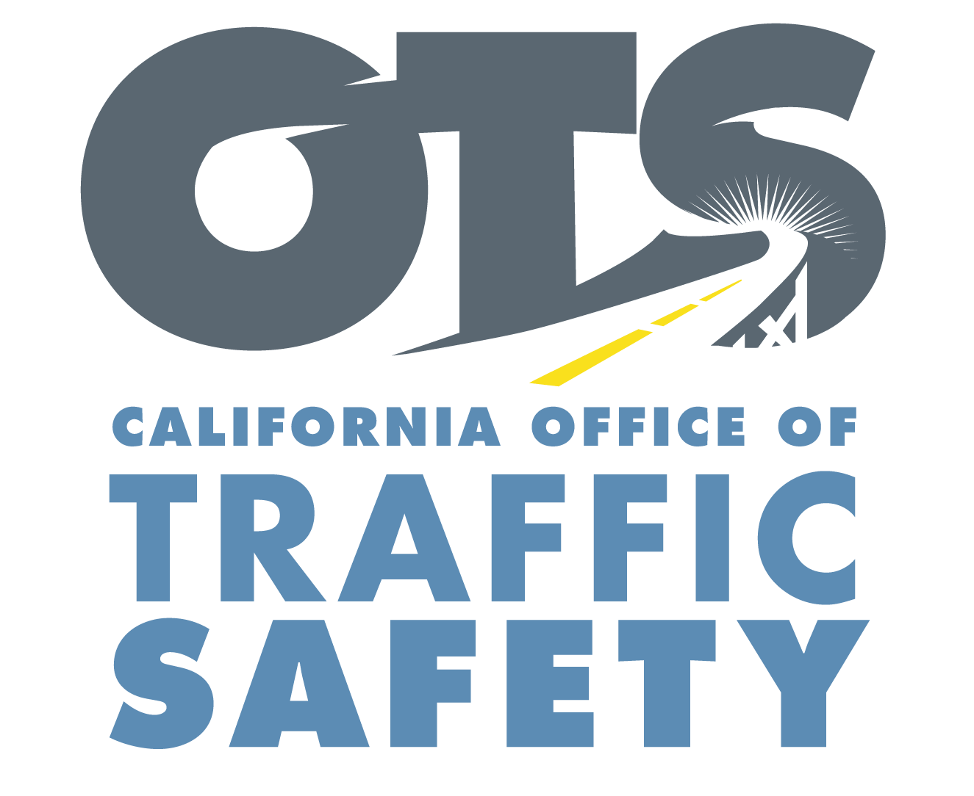

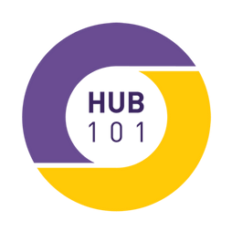


RELATIONSHIPS
Hub101
(CLU Incubator/ Coworking center)
Rev, Cornell’s Accelerator
(Summer 2023 Cohort)
Berkeley Sutardja Center
(alumnus)
CA Office of Traffic Safety
(Distracted Driving Office)
Ace Driving School
(Local driving school. Direct access to our target customer)
and more to come!

Slide 35

06
Grant
Questions

Slide 36
EDUCATIONAL VALUE
Having a current full-time CLU student and a recent Cal Lu alumni on the team.
Doing a pilot study through CLU to get real data on the changes in driving behavior as a result of PhoneBelt
Talked with Mike about a podcast from the various grant recipients sharing their lessons and insights
Offering electrical engineering workshops at CLU (CLU has no dedicated engineering departments). This would be especially interesting for the CS students as it would be an exposure to bit level programming through microcontrollers and a gateway to embedded engineering
I am also open to coffee chats, hardware/ manufacturing workshops, CLU radio, entrepreneurship case studies.
I attended all the CLU entrepreneurship events this year: Startup Weekend, PRiME, IdeaToDo, and the New Venture Fair. I also frequent Hub101. One of the best ways for me to be accessible and be a resource to others is to just be around and be a shoulder tap away!

Slide 37
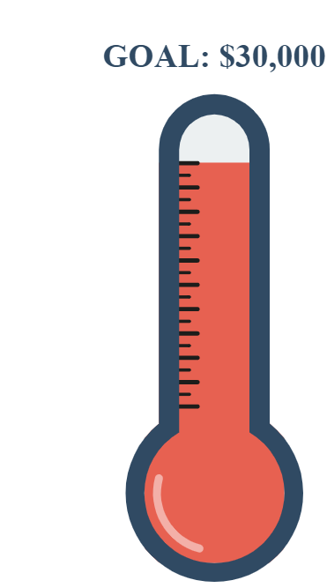
USE OF FUNDS
$5000
This will be earmarked for doing a pilot study with the CLU Mathematics and Business departments as discussed with Professor Metz. This study will be valuable to CLU students who will design, implement, and analyzing this pilot study. PhoneBelt can then leverage the results as evidence to attracting public and private partnerships
$5000
This will be earmarked to expand our team and allow us to reach our goals faster by hiring a CLU student as an intern. As the company finishes up the R&D and engineering, a marketing focus will be key to create social media content and especially generate pre-sales.
$20,000
The rough quote for the tooling costs necessary for injection molding. The current designs are all 3d printed and in order to scale and fulfill our kickstarter, injection molded parts will be necessary. A large portion of the accelerator James will be attending will be designing the product for injection molding and scalability
5k-
5k-
20k-
Gist: This grant will be pivotal to getting us to our next milestone, launching on Kickstarter

Slide 38
Thank you!
Appendix:
Website: ThePhoneBelt.com
Contact: jamescscoleman@gmail.com

Slide 39
MOATS
First Mover Advantage
Long term contracts and subscriptions with strategic partners (Coordination with National Teen Safe Driver Week)
Best in class customer service
Unique design and approach to the phone mount
Building a very high quality product, competing on quality not price
Key partnerships especially with distribution, awareness, and marketing
Selling initially only in U.S.- preventing knock-offs, building a better moat, de-risking business
Build a robust supply chain and leverage economies-of-scale
Regulation in safety space will make knock-offs difficult
Natural barrier to entry - Expensive tooling costs, government certification, etc.
Leverage studies, data, and evidence that competitors do not have
Leverage customer data, customer lock-in, customer stickiness
Network effects, especially in parental customer segment
Branding and Intellectual Property

Slide 40
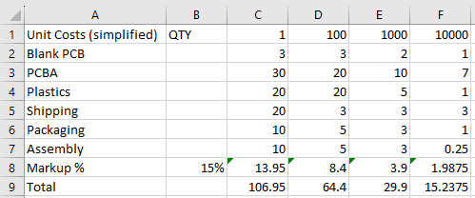
UNIT COSTS (simplified)

Slide 41
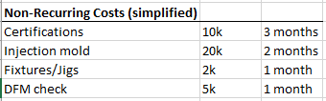
NR COSTS (simplified)

Slide 42
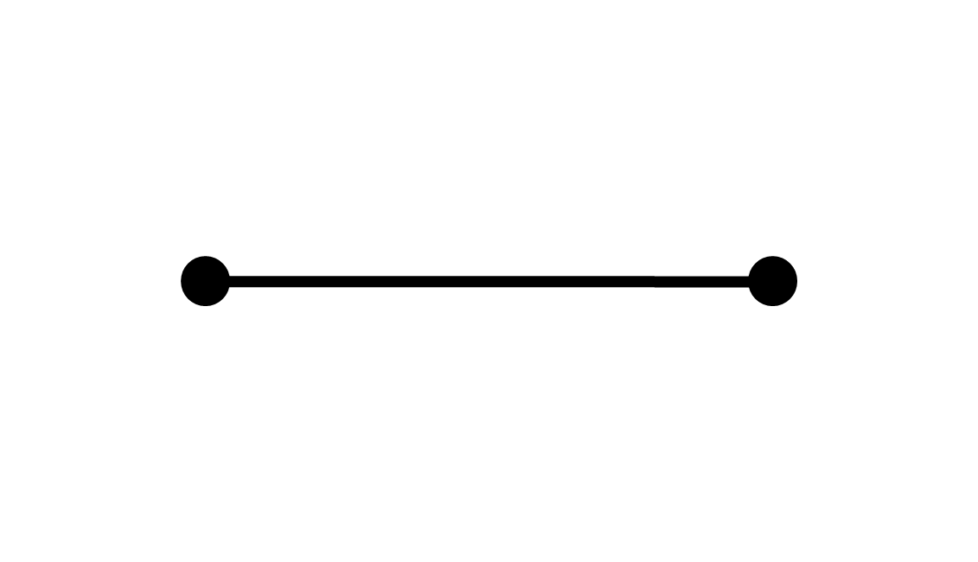
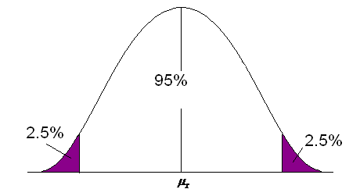
Slide idea
Our opportunity
No solution whatsoever
Invasive driver facing cameras

Slide 43
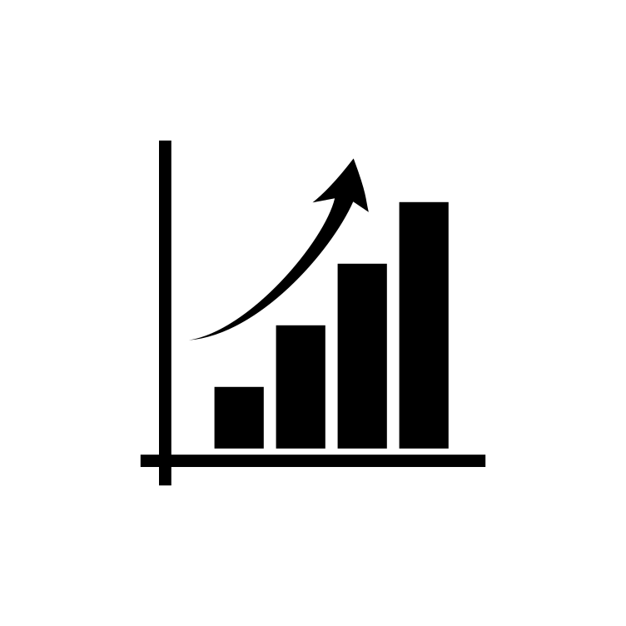
The Problem
Smartphone ownership
Time spent on phones
Time spent manipulating phone while driving

Slide 44
Evidence
75% of drivers sometimes use their phone while driving, common reasons are GPS, music, calling (AT&T)

Slide 45


Phone mounts reduce accidents when used (Accident Analysis & Prevention)
People just take their phone out of the holder when the want to use it (FHWA)

Slide 46
Business Model - more than just B2C. HAAS?
Commercial trucking is oversaturated with competition
People simply do not like cameras watching them
Extremely untapped B2B market: door to door vehicles
Traditional B2C Business Model.
Hardware as a service (HAAS) for B2B customers

Slide 47
Budget Forecast & Funding Plan
Financial Road Map - cost segmented by quantity
Simplified Unit Costs

Slide 48
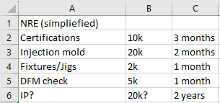
Costs
Simplified non-recurring costs

Slide 49
Why It Matters
Scenario 1
$50,000 in Apple = 140 shares of Apple
AKA 0.00000002 of Apple
Tim Cook won’t notice
Scenario 2
Potentially change the world.

Slide 50
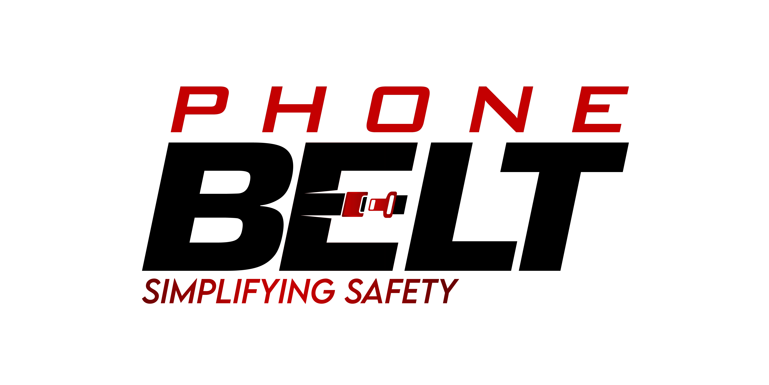
In short, we see a future where phonebelts become as ubiquitous as seatbelts.
Questions?
Contact: jamescscoleman@gmail.com

Slide 51
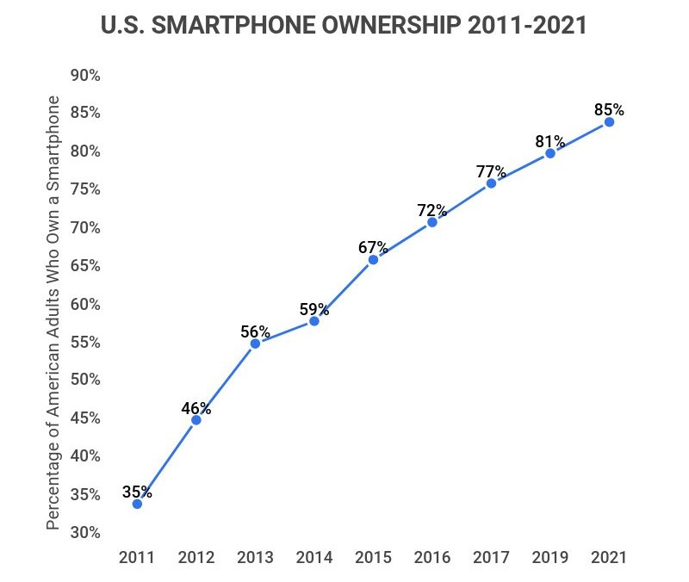
Homage to the seatbelt
The seatbelt is a piece of hardware that has saved millions of lives.
Only 10% of drivers used seatbelts as recently as 1980. Today that number is 91%. The US was a late adopter
Despite only 9% of people being non-seatbelt users, they accounted for half of vehicle deaths
In 1959 the “modern” 3-point seatbelt was patented by Nils Bohlin on behalf of Volvo in Sweden
His mission: make a simple and effective solution that people could fasten with one hand, and that they would actually use
The seatbelts were crash tested using human volunteers and for higher speeds, human corpses
1961 - Wisconsin Becomes First State to Require Seat Belts to be installed in cars but no mandatory usage
1968 - All cars must come equipped with some form of a seatbelt
1973 - NHSA mandate requiring seat belt interlock mechanism is announced. Unpopular with public and automakers
1980s - Reagan’s platform of deregulation disposed of the requirement, insurance companies sued and the supreme court unanimously mandated the return of seatbelt laws
1984 - New York Mandates the use of seatbelts
Ideal seatbelt? 6-point harness? Tradeoff of simplicity vs safety. The just drive better solution is not a reality. Similarly, the keep your phone off and in the trunk is not either. Phones are increasingly not only being used while driving but also used for work while driving. The visual of the amazon delivery driver. The uber driver. The electrician driving from house to house. Its hard to think of a job that requires travel where the driver isn’t using their phone while driving.
In 2002, Volvo estimated that over a million lives were saved by seat belts.
Not only do cars have to include seat belts, they have to be used, and they chime loudly to incentivize seat belt adherence
Final note of how new smartphones are. The graph illustrates why this problem and the solutions are still in their infancy and why they lack and form of standardization.

Slide 52
Existing (worse) Solutions
Phone Mount
TruceSoftware
PhoneBelt
No enforcement of use
Provides employers with aggregate data. Privacy issues & “big brother” esque
No enforcement of use
Problem
$18 regular
$35 charging
High hardware setup fee
Recurring monthly fees
$18 regular
$35 charging
Costs
Allows phone to be used as a tool while driving
Hardware in car. App must be download. Sends data to employer.
Allows phone to be used as a tool while driving
Benefits
Attaches to car, typically via suction cup
Hardware in car. App must be download. Sends data to employer.
Attaches to car, typically via suction cup
Form Factor

Slide 53
The problem
Consumer
The story of Rachel the high schooler that just got her license and her mother
Accidents are the leading cause of death for teenagers. Over 1/3rd of teen deaths.
The United States government estimates that at any given moment 8% of drivers are using their cellphone. That is over a million drivers at this moment.
1.6 million crashes involved cell phone use
¼ of all crashes involve cell phone use
NSC find that cell phone caused crashes are exceptionally underreported
94 percent of drivers support a ban on texting while driving.
Enforcement of banning cell phones is the problem
Enterprise
Commercial driving is the #1 cause of work fatalities (24%)
A non-fatal crash due to distracted driving costs employers on average $100,310
Settlements for fatal crashes are far higher, often in the 10s of millions range
Additional costs: fixing the at fault vehicle, the driver’s injuries, the opportunity cost of the driver not working, the opportunity of the truck not being driven, the increased insurance costs, and the incalculable damage to the brand
The number of million dollar settlements increased roughly 1000% from 2010 to 2018. One accident can be a bankruptcy
Overall distracted driving costs employers about $18.8B a year (including property damage and fatal accidents too)

Slide 54
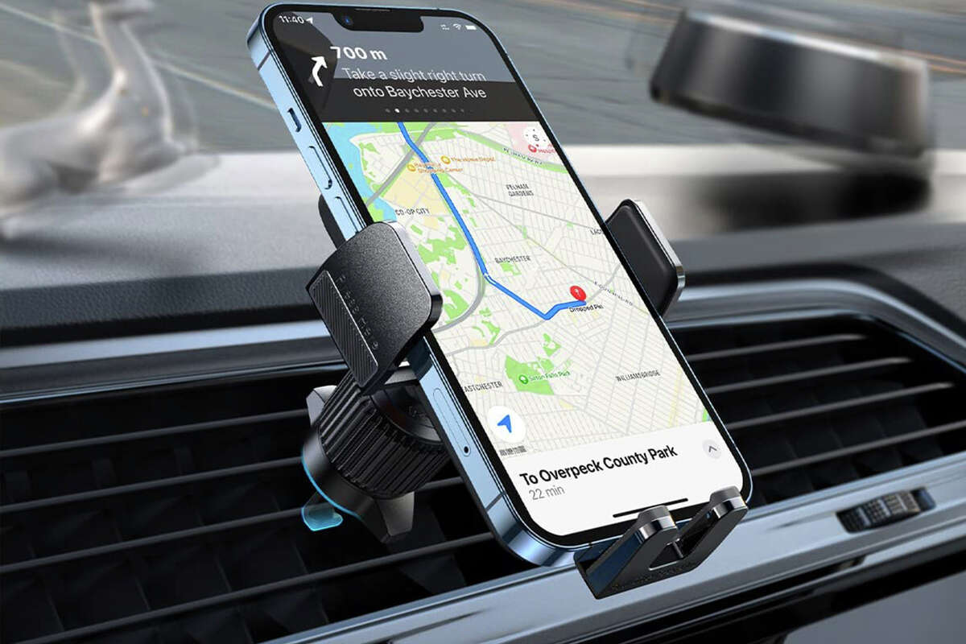
A better solution
Key Characteristics
Phone Belt satisfies everyday drivers and commercial drivers with its easy-to-use and easy-to-adopt design
Place mount on dashboard
Consumer Needs
Keep young drivers
dogs
Adjust to desired height & angle
Commercial Needs
Pull battery tab
Lower accidents
Save money
Setup complete
The Technology
Proximity Sensing
Motion Detection
Contact Sensor
Buzzer
Proximity sensing to open arms fast and easy
Determining when vehicle is in motion to activate
Detects whether phone is in the mount or not
Chirping when in motion and when phone is not buckled

Slide 55
Jan 2023
Sept 2022
Selling Points
We offer
Features
Alternative systems are expensive
Alternative systems are difficult to install and difficult to enforce
Currently no standards on holder location, grip, or mount type
The easiest installation in the industry. Peel. Stick. Pull. Done
Using the dock is easy. Place phone in 1 second with 1 hand.
Incredibly reliable, sturdy, and versatile across phone types
Mute button for rare cases of no phone
Completely closed system to make product maximally tamper resistant and reliable. Recurring revenue stream for replacements
Opportunity
Market Changes
Buckle’s Positioning
Alternative systems are expensive
Alternative systems are difficult to install and difficult to enforce
Currently no standards on holder location, grip, or mount type
Governments do not know what to do
Increasingly commercial drivers are needing their phone to work
Consumer time spent on the phone is increasing every year
First mover advantage
Low Cost relative to competitors
Scalable B2B & B2C users
IP buffer against competitors
Network of strategic partnerships and relationships

Slide 56
Validation
Evidence. Anecdotal, statistical, purchase orders.

Slide 57
Milestones
September 2022
Idea formed
MVP on Arduino
December 2022
Works-Like Prototype
January 2023
PPA filed
LLC filed
Feels-like prototype
Grants
February 2023
April 2023
Engineering Prototype
Fundraising
Hiring team/freelancers
Strategic partners
Plan w/manufacturers
Pre-production prototype
Crowdfunding
May 2023
EVT/PVT/DVT
Certifications filed
B2B deals

Slide 58
Concerns and Responses
Concerns
Responses
Larger Company will mimic product
IP protection and benefits of being first to market
Self driving cars eliminate risk
99% of cars on the road are not self driving. Drivers of self driving cars still need eyes on road
Hardware scales slow relative to software
True
Nature of product will inevitability of litigation issues
True
No defining industry standard
Flexibility in the industry promotes innovation; a standard will soon be reached
No defining industry standard
Flexibility in the industry promotes innovation; a standard will soon be reached

Slide 59
Company Vision
Less variety and more standardized approach to phone mounting
Take eyes off smartphones and back onto the road
Save lives of not only the drivers (like seat belts do) but also passengers, pedestrians, and motorists sharing the road
Save businesses millions in distracted driving related costs
Create the most affordable life insurance policy money can buy
Be the intersection of simplicity and safety

Slide 60
Market Analysis
Marketing
Expanding and undersaturated marketplace
Position
First mover in a highly partnership oriented niche
High Growth Potential

